Slide 1

Devices and Ablations
NICOR 2023 Report
Mark Dayer
Clinical Lead, National Audit of Cardiac Rhythm Management, NICOR
Consultant Cardiologist, Somerset NHS Foundation Trust
Honorary Associate Professor, University of Plymouth, Faculty of Health

Slide 2
Conflicts of interest
(past 3 years)
Departmental research fellow supported by Abbott

Slide 3
Structure
Background
Procedure numbers – recovery from the pandemic
New Technology
Hospital Volumes
Operator Volumes - Trainees
Reintervention Rates

Slide 4

1st April 2021 – 31st March 2022
A whole year behind…

Slide 5
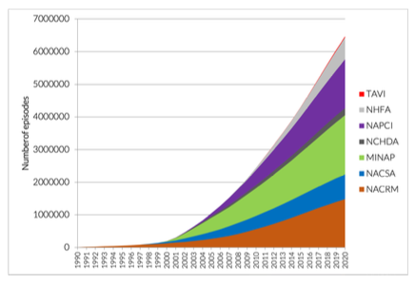
NICOR – National Institute for Cardiovascular Outcomes Research
NACRM – National Audit of Cardiac Rhythm Management
More than 30 years old – Tony Rickards / David Cunningham
Formally established in 2011 at UCL (CCAD)
1.4m+ procedures held by NICOR relating to NACRM
Currently in a state of flux due to recent move
UCL (2011)
Barts
Arden and Gem (2022)

Slide 6
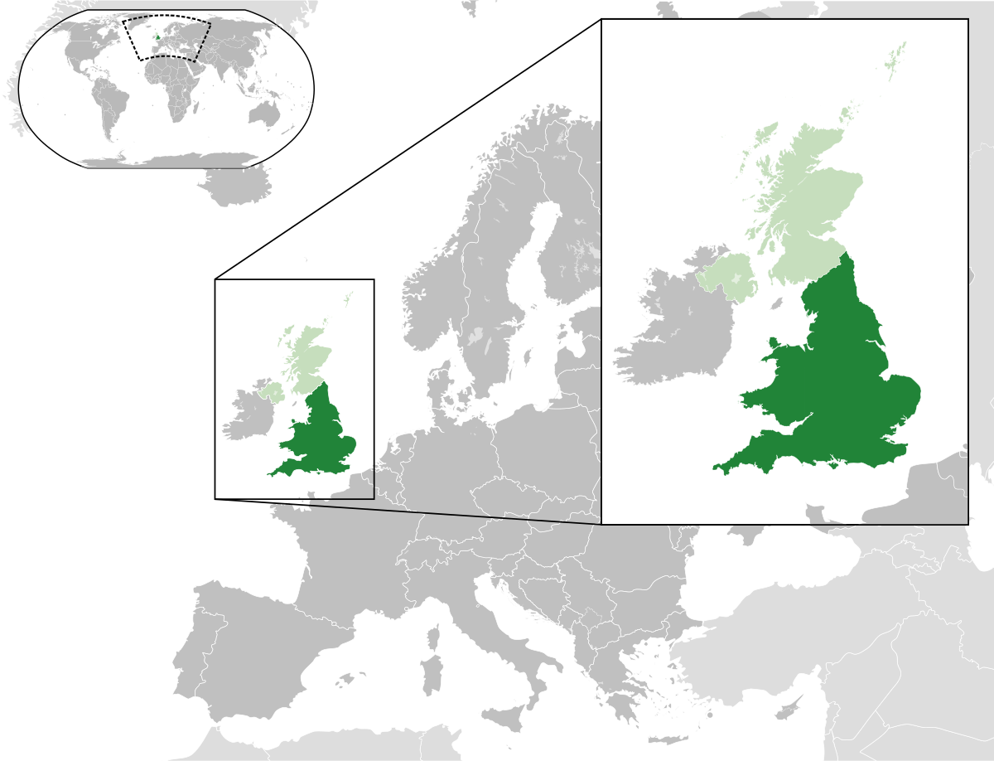
England and Wales only
Notes:
https://upload.wikimedia.org/wikipedia/commons/thumb/b/b6/England_and_Wales_within_the_UK_and_Europe.svg/1200px-England_and_Wales_within_the_UK_and_Europe.svg.png

Slide 7
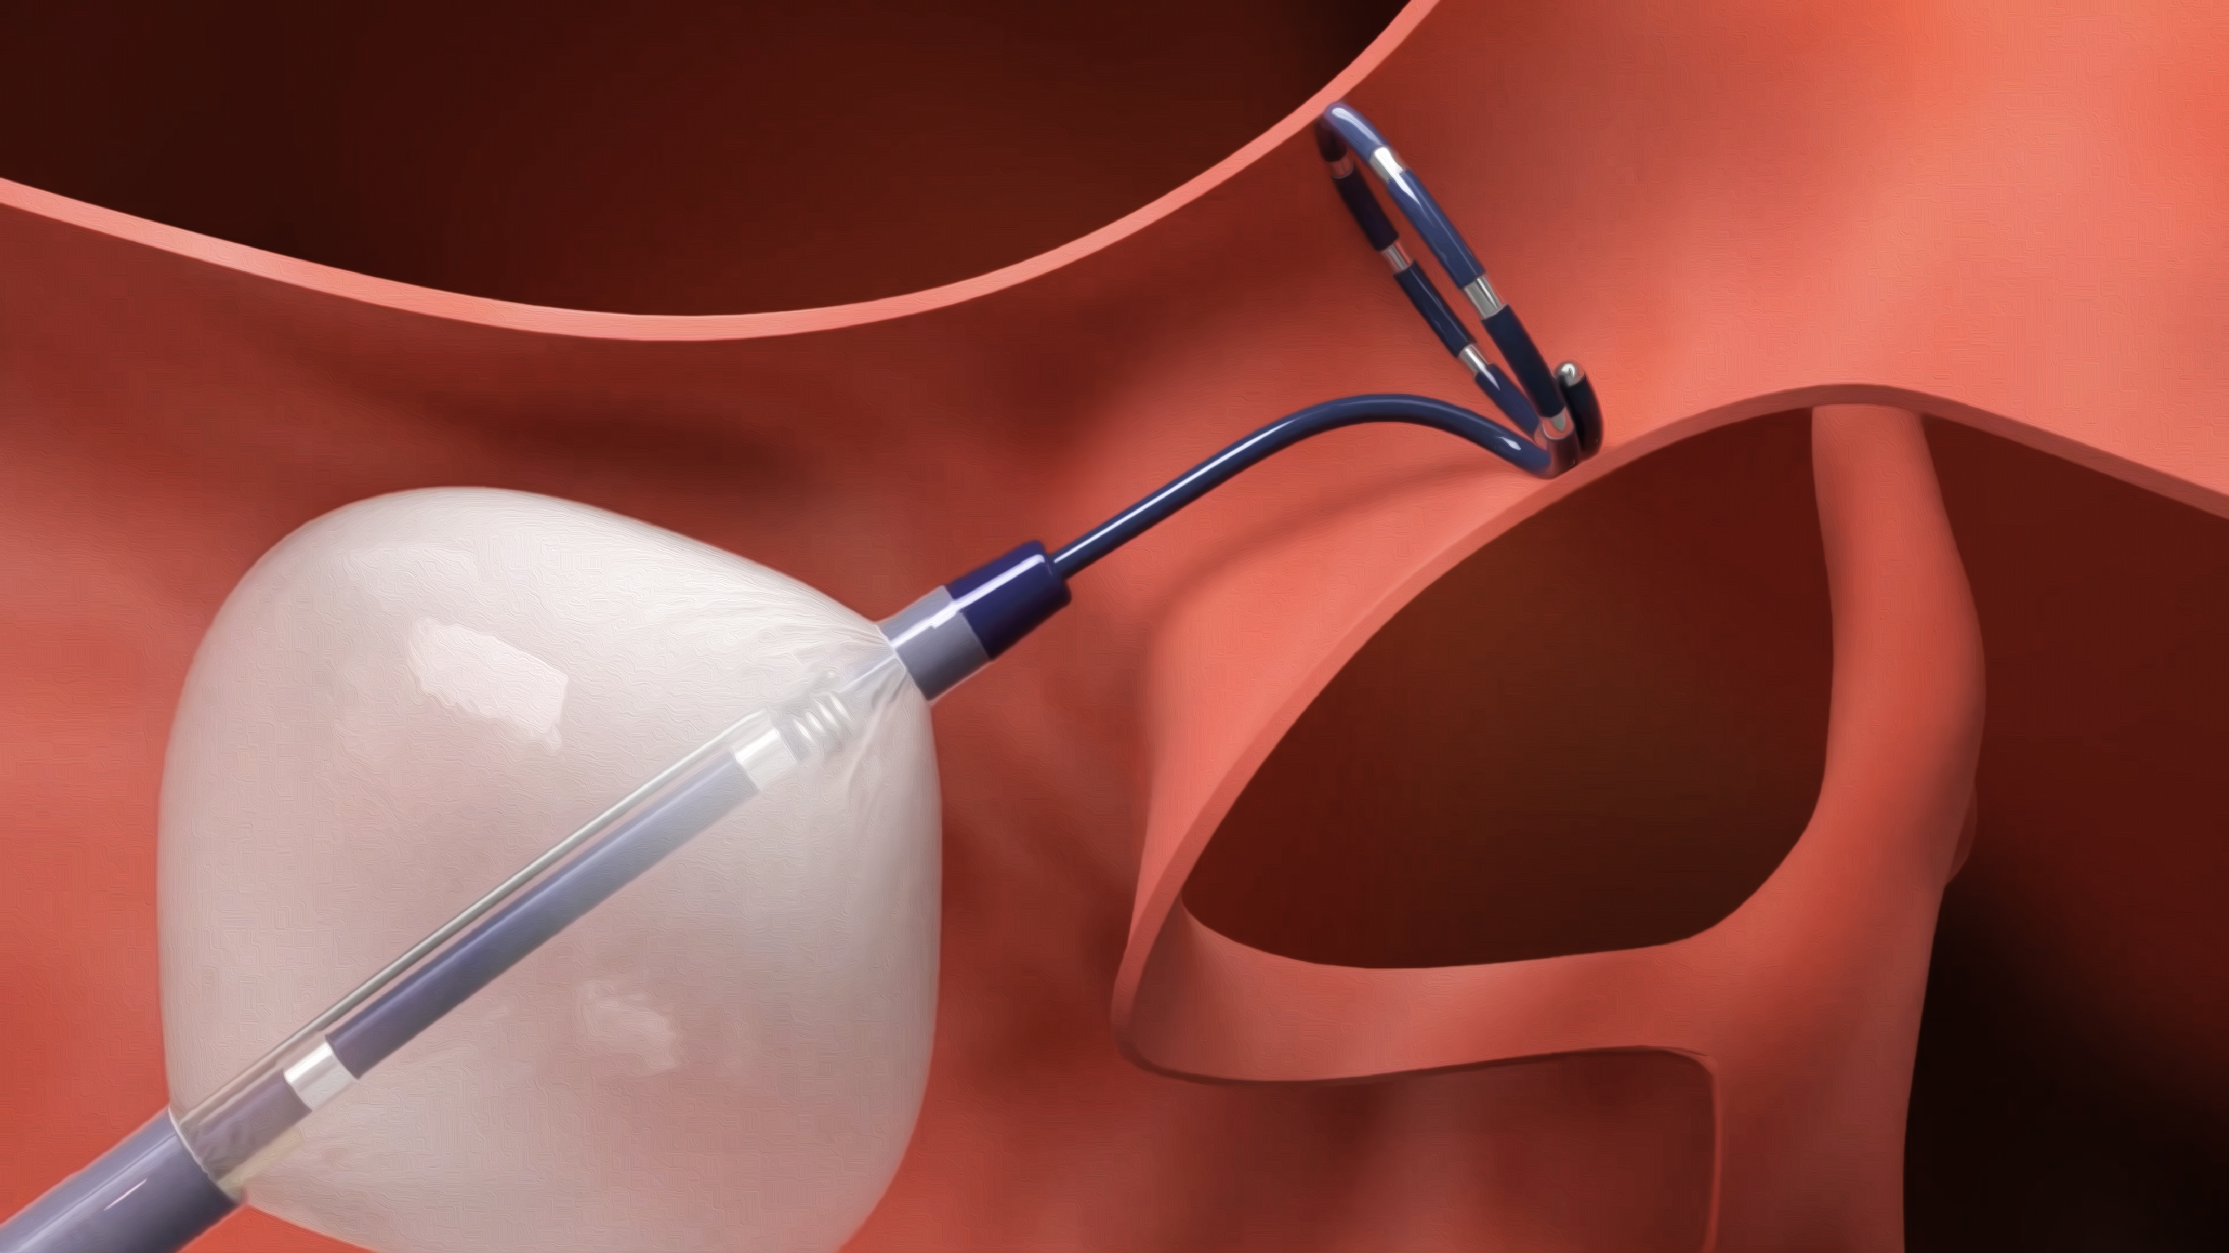
Procedure Numbers
Notes:
https://www.bostonscientific.com/content/dam/bostonscientific/ep/portfolio-group/single-shot/polarx/5731%20Video%20Thumbnail%204.png

Slide 8
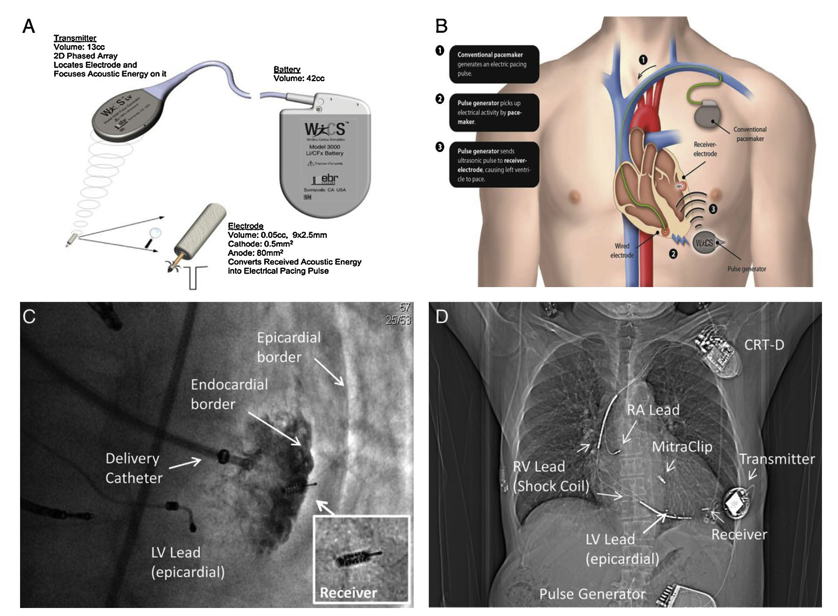
Definitions
“Simple” devices
  AAIR, VVIR, DDDR pacemakers
“Complex” devices
  Any ICD or CRT devices
Leadless cardiac pacemakers
  LCPS
  Micra principally – counted as “simple”
  A handful of WICS – counted as “complex”
Notes:
Seriwala et al. 2016, http://dx.doi.org/10.1016/j.jjcc.2015.09.006

Slide 9
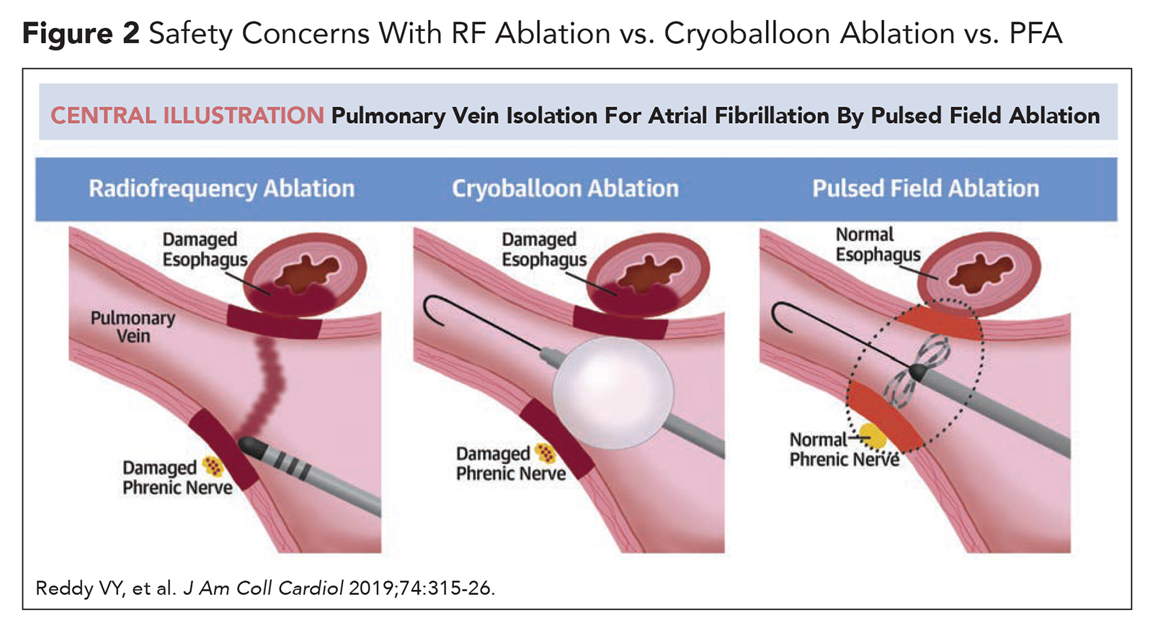
Ablation
“Simple Atrial (A)”
  AV node ablation
  Slow pathway
  Accessory pathway
  Cavo-tricuspid isthmus
“Complex Atrial (A)”
  Atrial fibrillation
  Atrial tachycardia
  Anything else that isn’t simple
“Complex Ventricular (V)”
  Any ventricular target
Notes:
https://www.acc.org//-/media/Non-Clinical/Images/2021/06/CARDIOLOGY/15/FOCUS-on-EP-Figure-2-1600px.jpg
https://www.acc.org/latest-in-cardiology/articles/2021/06/01/01/42/1-shot-techniques-for-pulmonary-vein-isolation-in-afib-cryoablation-to-pulse-field-ablation

Slide 10
Devices
A total of 172 centres reported ablations in 2021-2022.
150 were NHS adult hospitals. 19 were private hospitals, and the remaining 3 were children’s hospitals.

Slide 11
All device procedures over time

Slide 12
All device procedures over time
Drastic fall in procedures in first lockdown

Slide 13
All device procedures over time
Drastic fall in procedures in first lockdown
Failure to recover to pre-pandemic levels

Slide 14
Device Procedures
More detail on trends – all procedures

Slide 15
Procedures in more detail
England
 | First Implant | Generator Change | Upgrade | Other | Undefined | Total
PPM (total) | 26,016 | 8,717 | 146 | 2,391 | 2,237 | 39,507
LCP | 243 | 16 | 2 | 65 | 23 | 349
ICD-TV | 3,526 | 1,038 | 99 | 473 | 395 | 5,531
ICD-Subcutaneous | 521 | 181 | 4 | 77 | 52 | 835
CRT-P | 2,701 | 891 | 789 | 377 | 464 | 5,222
CRT-D | 2,162 | 1,448 | 548 | 516 | 374 | 5,048
Other/blank | 991 | 371 | 55 | 615 | 2,415 | 4,447
ILR | - | - | - | - | - | 9,630
Wales
 | First Implant | Generator Change | Upgrade | Other | Undefined | Total
PPM (total) | 1,272 | 257 | 5 | 66 | 33 | 1,633
LCP | 1 | 0 | 0 | 0 | 0 | 1
ICD-TV | 157 | 20 | 2 | 11 | 1 | 191
ICD-Subcutaneous | 1 | 1 | 0 | 0 | 0 | 2
CRT-P | 172 | 30 | 27 | 13 | 4 | 246
CRT-D | 104 | 37 | 24 | 15 | 6 | 186
Other/blank | 180 | 35 | 2 | 37 | 140 | 395
ILR | - | - | - | - | - | 202
England and Wales
 | First Implant | Generator Change | Upgrade | Other | Undefined | Total
PPM (total) | 27,288 | 8,974 | 151 | 2,457 | 2,270 | 41,140
LCP | 244 | 16 | 2 | 65 | 23 | 350
ICD-TV | 3,683 | 1,058 | 101 | 484 | 396 | 5,722
ICD-Subcutaneous | 522 | 182 | 4 | 77 | 52 | 837
CRT-P | 2,873 | 921 | 816 | 390 | 468 | 5,468
CRT-D | 2,266 | 1,485 | 572 | 531 | 380 | 5,234
Other/blank | 1,171 | 406 | 57 | 652 | 2,555 | 4,842
ILR | - | - | - | - | - | 9,832
Pacemaker | AAIR, VVIR, DDDR, VDDR
LCP | Leadless cardiac pacemaker, identified from field 3.20, generator model
ICD-TV | ICD-VR, ICD-DR, ICD-VDDR
Note - if field 3.11 or 3.12 blank, not reported
When 3.11 = 9 - monitor procedure, that is not broken down by intervention category
April 2021 – March 2022

Slide 16
Reported Activity – England & Wales
This table shows changes in reported activity. It uses data from two fields. The first field is “3.11, intervention category”. The second is “3.12, maximum system capability”. These two are combined together as follows:
From 3.11, intervention category, the following (1-5) are included:
New system (first implant)
Generator change
Upgrade
Generator + lead change
Downgrade
From 3.12, maximum system capability:
Pacemaker: AAIR, VVIR, DDDR.
ICD: ICD-VR, ICD-DR, ICD-SQ
CRT-P+D: CRT-P, CRT-D
England
System | 2020-21 | 2021-22 | % Change
Pacemaker | 33,738 | 35,904 | 6.4
ICD (not CRT-D) | 4,890 | 5,581 | 14.1
CRT-P/D | 7,782 | 8,894 | 14.3
Wales
System | 2020-21 | 2021-22 | % Change
Pacemaker | 1,323 | 1,562 | 18.1
ICD (not CRT-D) | 176 | 186 | 5.7
CRT-P/D | 348 | 405 | 16.4
Notes:
Note - 4 nudges to keep tables apart.

Slide 17
Annual device numbers
Still behind

Slide 18
Devices over time

Slide 19
Devices as a proportion of activity

Slide 20
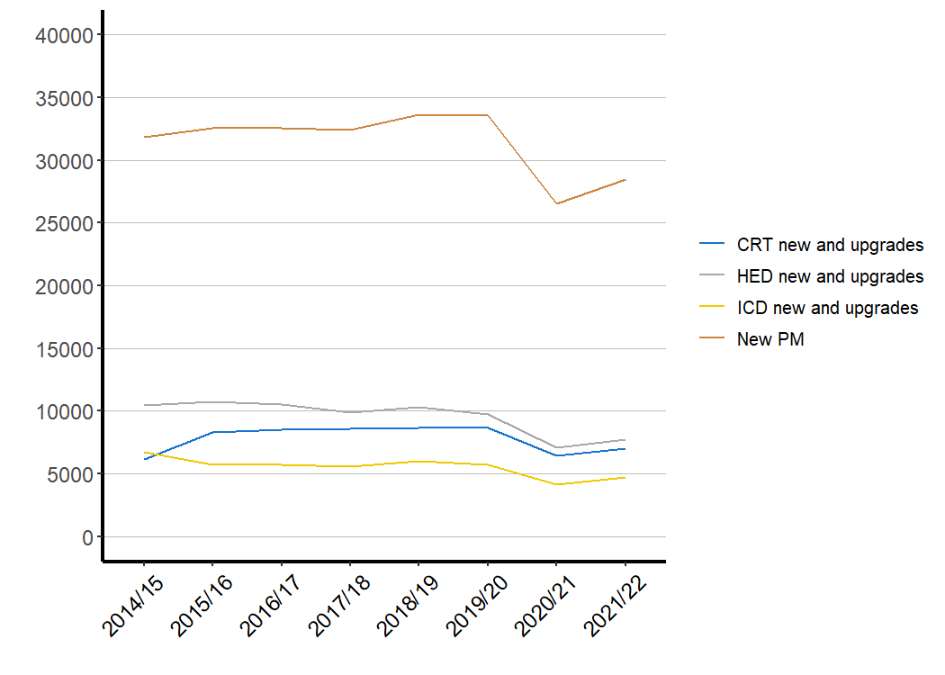
Devices – Total Implants

Slide 21
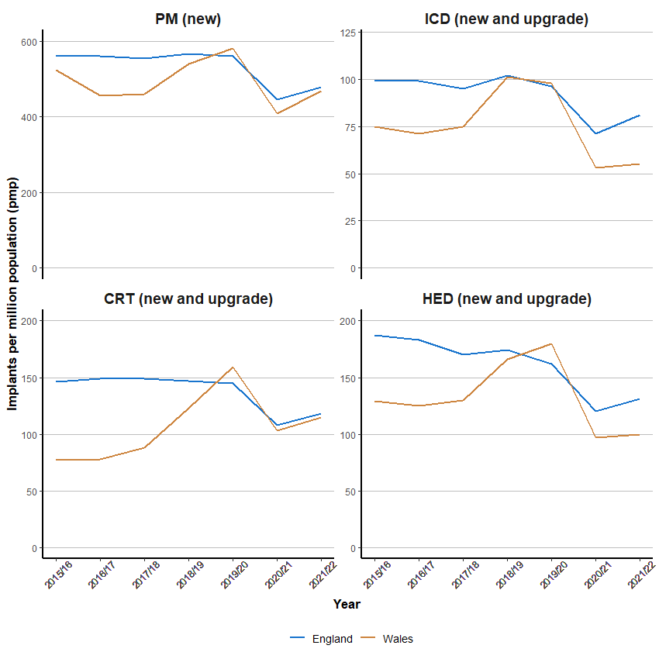
Devices per million population

Slide 22
Ablation
A total of 59 centres reported ablations in 2021-2022.
43 were NHS adult hospitals, 4 were children’s hospitals and the remaining 12 were private hospitals

Slide 23
It’s the same for ablations. But even more so.
All ablation procedures over time.
Notes:
As previously reported, during the two lockdowns, which started in March 2020 and December 2020, there was a dramatic fall in the number of ablations performed, particularly during the first lockdown.
Rates recovered during the summer of 2021, but rates then gradually fell, and there has not been a recovery in the reported numbers of ablation, let alone growth in rates, to make up for the shortfall.

Slide 24
Projections
The blue bars represent actual activity.
The orange bars uses the last 5 data points (2015-2019 data) and project forwards using a single order polynomial.
It is clear that activity is far below what would be expected.
  Expected: 42,797
  Actual: 31, 527
26% down – 6 months of activity

Slide 25
Recovery in ablation numbers by region
Recovery has been uneven across the country

Slide 26
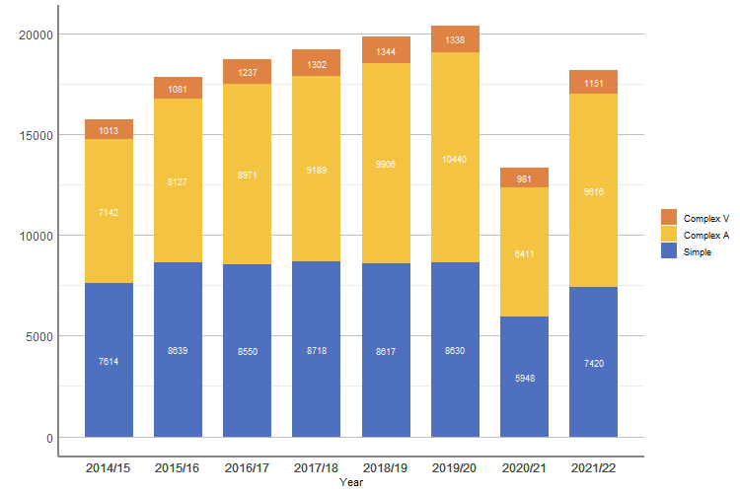
Yearly Ablation Numbers
This chart demonstrates that pre-pandemic ablation numbers were rising consistently.
There was a dramatic fall in 2020/21.
There was some recovery in the numbers of ablations performed in 2021/22, but numbers were still below 2016/17.
Notes:
I had better know what is in simple / complex A / complex V
Is all ventricular ablation complex?
Simple – presumably AVNA / AVNRT / AP / Afl
Complex A – AF / EAT/IART

Slide 27
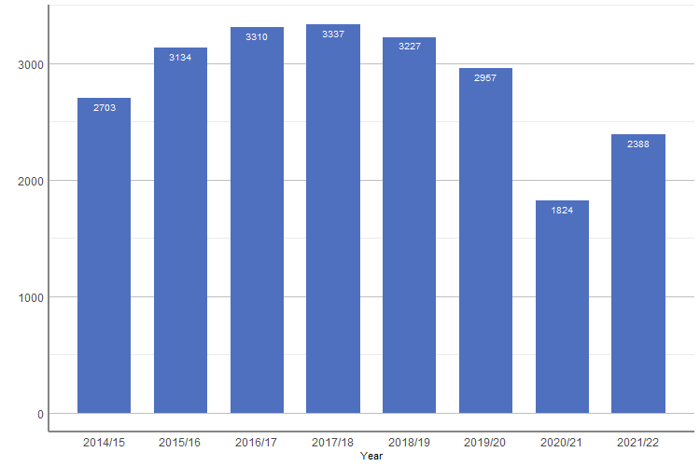
AVNRT
AVNRT ablations were falling pre-pandemic, possibly as AF ablation became more common.
There has yet to be a recovery to pre-pandemic levels of activity.

Slide 28
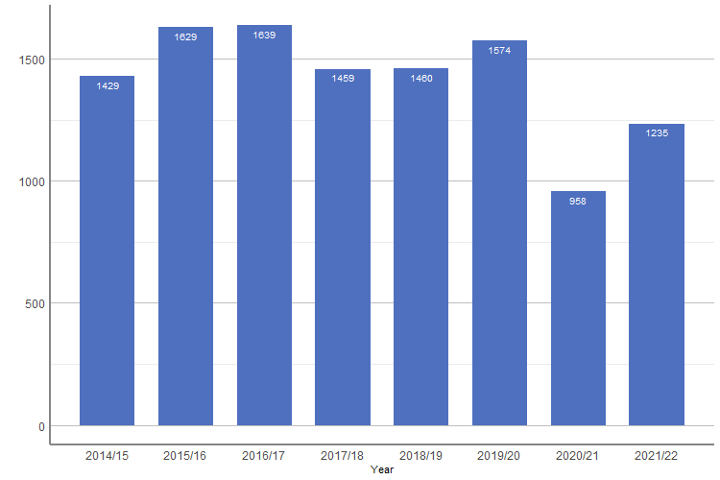
Accessory Pathways
Ablation of APs was static pre-pandemic.
It has followed the traditional pattern of a dramatic fall and then partial recovery.

Slide 29
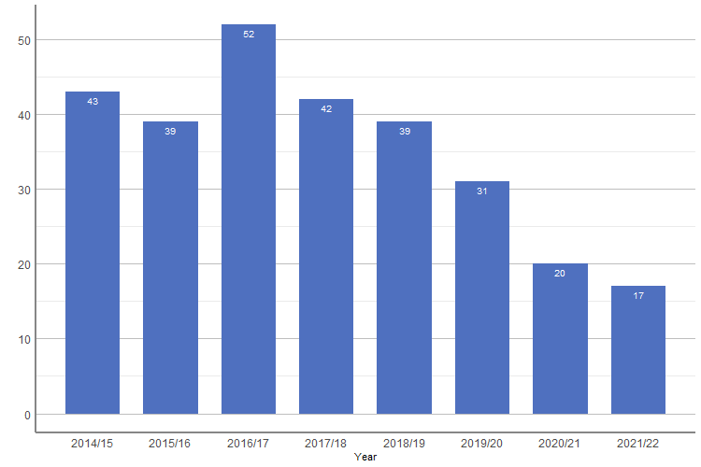
Simple – Multi-target Ablation
Procedures tackling more than 1 “simple” ablation are becoming less and less common.

Slide 30
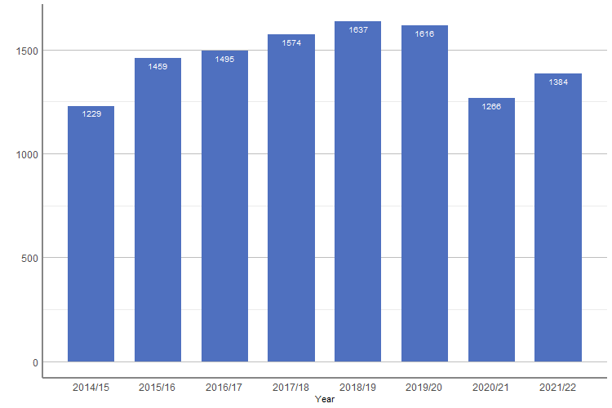
AV Node Ablation
AV node ablations have become more common, particularly in combination with cardiac resynchronisation therapy.
Nonetheless, numbers are still below the pre-pandemic levels.

Slide 31
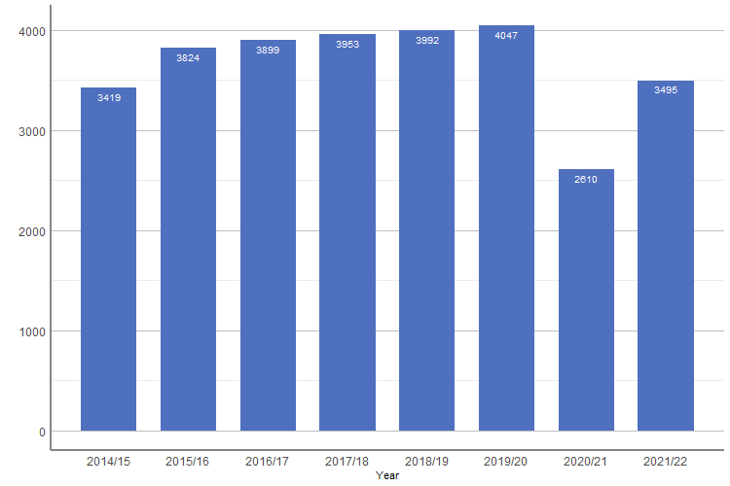
Typical Atrial Flutter
Flutter ablations had been growing very slowly pre-pandemic.
There has been a clear increase in activity in 2021/22 but only to 2014/15 levels.
Notes:
CTI – Cavo-tricuspid isthmus.

Slide 32
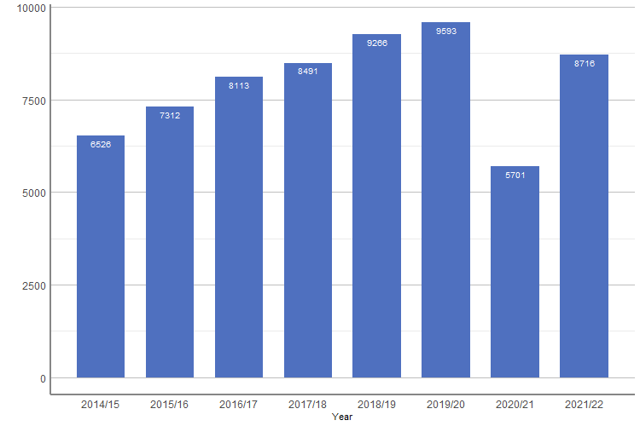
AF Ablation
AF ablation fell in 2020/21 but appears to be recovering quickly.

Slide 33
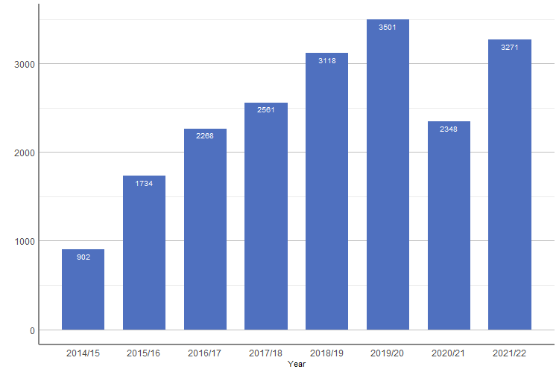
Cryoablation for AF
Cryoablation appears to be gaining in popularity.
14% of AF ablations used Cryotherapy in 2014/15.
In 2021/22, it was 38% of all AF ablations.
Numbers exceeded those in 2018/19.

Slide 34
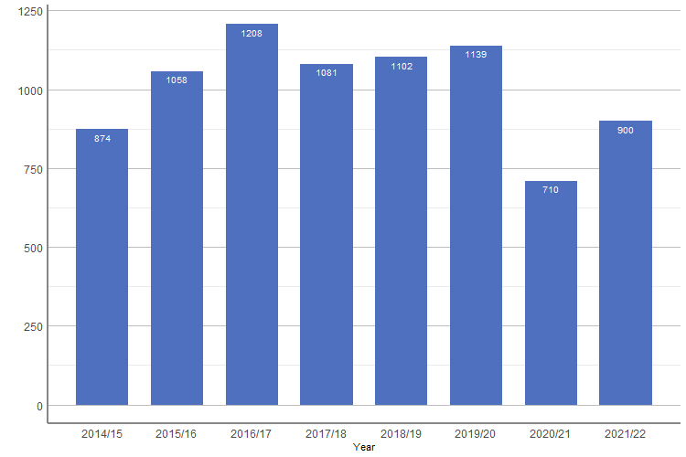
Ectopic Atrial Tachycardia / Intra-Atrial Re-Entry Tachycardia
There was a drop during the initial pandemic with poor recovery of activity to just above 2014/15 levels, although the absolute increase is encouraging.
Notes:
Is this ATs post AF ablation?

Slide 35
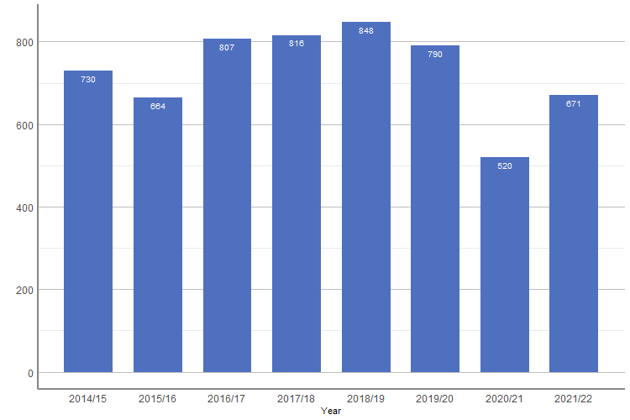
PVCs and Focal VT
Again, recovery is incomplete, but there was a marked uptick in growth in 2021/22 compared with 2020/2021.
Notes:
Focal VT – RVOT?

Slide 36
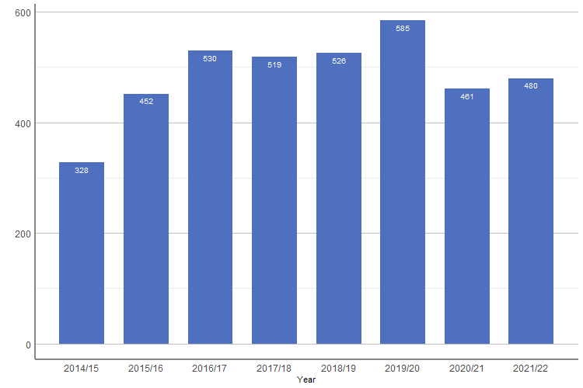
VT Ablation - Scar
VT ablation is an emergency procedure, and activity fell during 2020/21, but the fall was less marked than with other ablations.
Recovery in numbers has not been dramatic, indeed, surprisingly, unlike with focal VT, recovery has ben largely flat, and numbers in 2021/22 were broadly similar to 2015/16.

Slide 37
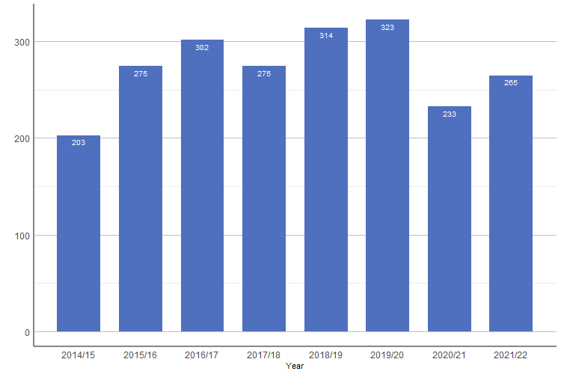
Congenital Heart Disease Ablation
Ablation in patients with congenital heart disease was rising pre-pandemic. There were >50% more ablations in 2019/20 than in 2014/15.
This number fell dramatically during the pandemic, and has recovered, but not to pre-pandemic levels.

Slide 38
“New” Technology

Slide 39
Complex device implants – new implants and upgrades
Gradual trend away from ICDs – DANISH?

Slide 40
Subcutaneous ICDs
Has their rise in popularity stalled?

Slide 41
Leadless Cardiac Pacemakers
Notable increase in LCP device implants.

Slide 42
Cryoablation in AF
Has cryo peaked?

Slide 43
No data on pulsed field ablation
Notes:
Francis will be collating that separately. It is hoped that it will be included in the NICOR data set.

Slide 44


Data Completeness – Devices
Target = $≥$90%

Slide 45

Data Completeness - Devices
Data Completeness
 |  | England | Wales
Demographics
1.03 | NHS Number | 98.7 | 97.6
1.04 | Surname | 100.0 | 100
1.05 | Forename | 100.0 | 100
1.06 | Date of Birth | 100.0 | 100
1.07 | Sex | 99.8 | 100
1.08 | Postcode | 98.9 | 99.2
Clinical Details - New implants / upgrades only
2.02 | Aetiology | 96.5 | 91.4
2.03 | Symptom | 96.2 | 96.9
2.04 | ECG | 93.1 | 81.0
2.05 | Atrial Rhythm | 91.5 | 70.2
2.06 | NYHA Class | 92.8 | 71.9 | Only for CRT procedures
2.07 | LV Function | 95.2 | 75.2 | Only for CRT procedures
2.08 | ICD Indication | 96.5 | 75.6 | Only for ICD procedures
2.09 | QRS Duration | 88.7 | 66.7 | Only for CRT procedures
2.10 | QRS Morphology | 97.6 | 96.9 | Only for CRT procedures
Procedure Details
3.03 | First Operator GMC Number | 88.5 | 85.4 | Excludes ILR procedures
3.09 | Consultant GMC Number | 90.7 | 87.1
3.11 | Intervention | 91.5 | 93.9
3.12 | System Type | 93.4 | 85.2
3.13 | Fluoro | 84.9 | 60.8 | Records in fields 3.11 = 1,3,4
5.01 | Acute Complications | 100.0 | 100.0
3.19 | Manufacturer | 96.5 | 84.2 | Records in fields 3.11 = 1,2,3,4,5
3.20 | Model | 99.5 | 97.5 | Records in fields 3.11 = 1,2,3,4,5
3.21 | Serial Number | 99.1 | 97.4 | Records in fields 3.11 = 1,2,3,4,5
The following table details data completeness. The target for all fields is $≥$95% (green).
That is good for demographic details but less good for other fields. In particular, a significant number of cases do not have a valid GMC number for the first operator, making it likely that procedure numbers, as reported, are lower than in reality.
Data completeness in England is generally better than in Wales.

Slide 46
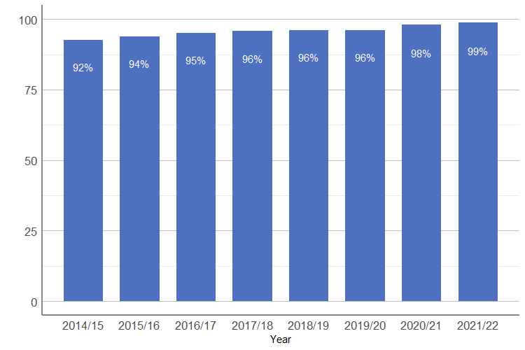
Demographic Fields Completeness - Devices
Generally improving over time

Slide 47
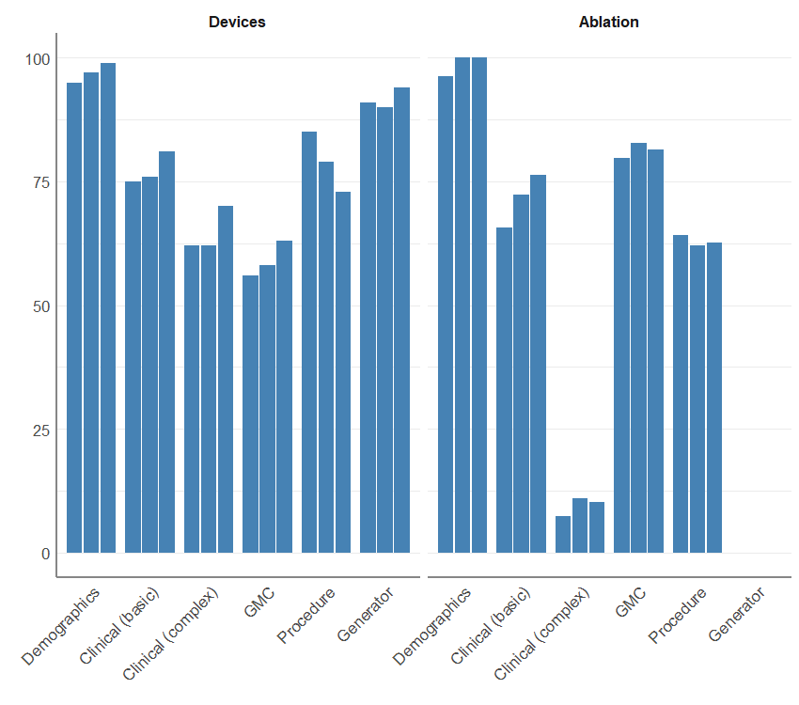
Percentage completeness of various fields
2019-20
2020-21
2021-22

Slide 48
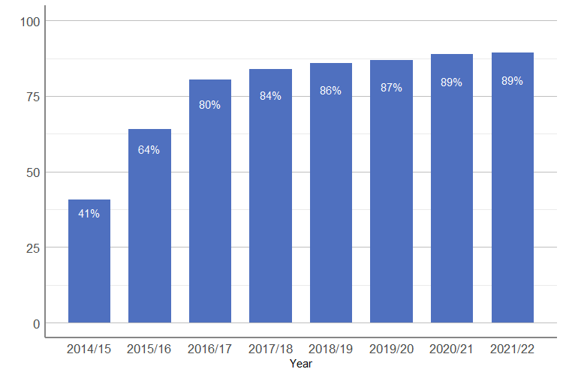
GMC Field Completeness

Slide 49
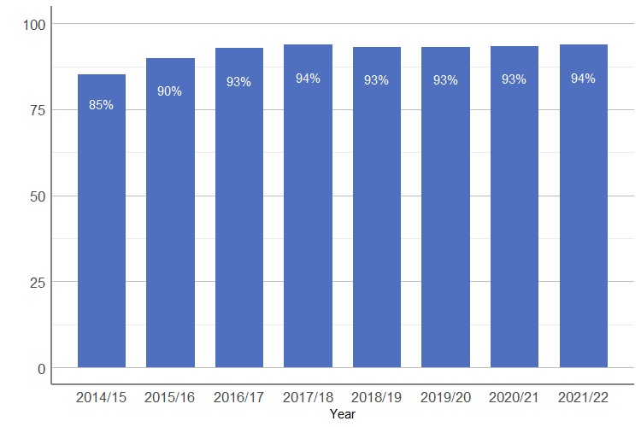
Clinical Simple Fields Completeness

Slide 50
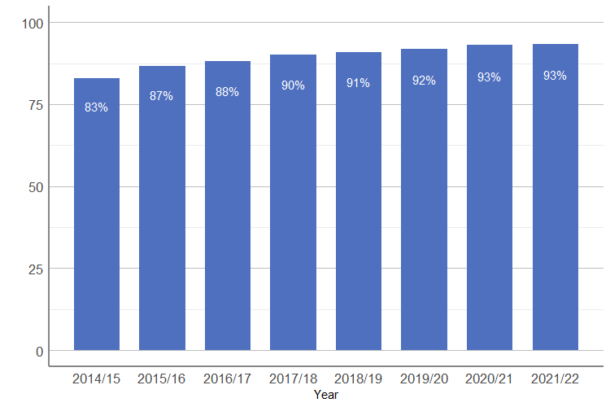
Clinical Complex Fields Completeness

Slide 51
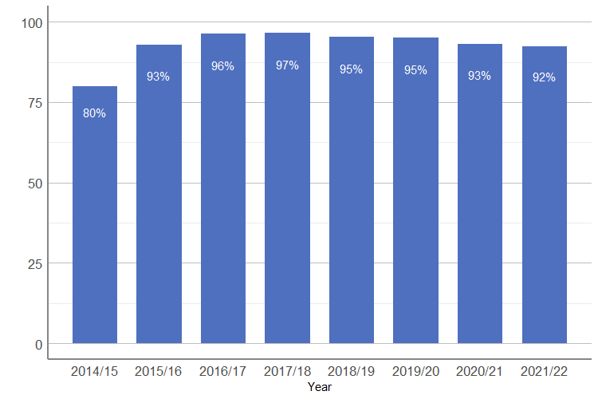
Procedure field completeness

Slide 52
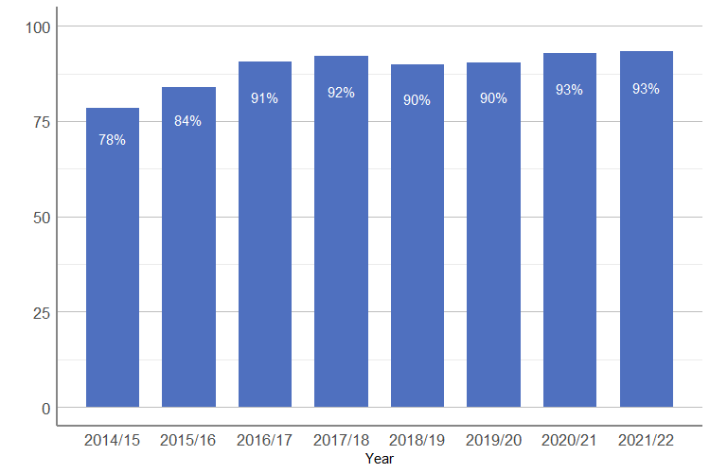
Validation Trends

Slide 53
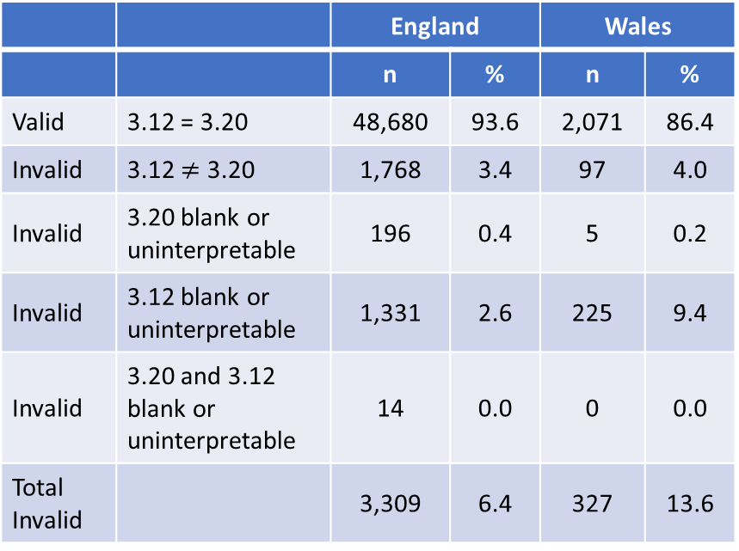
Validation Against Generator
 |  | England |  | Wales
 |  | n | % | n | %
Valid | 3.12 = 3.20 | 48,680 | 93.6 | 2,071 | 86.4
Invalid | 3.12 $≠$ 3.20 | 1,768 | 3.4 | 97 | 4.0
Invalid | 3.20 blank or uninterpretable | 196 | 0.4 | 5 | 0.2
Invalid | 3.12 blank or uninterpretable | 1,331 | 2.6 | 225 | 9.4
Invalid | 3.20 and 3.12 blank or uninterpretable | 14 | 0.0 | 0 | 0.0
Total Invalid |  | 3,309 | 6.4 | 327 | 13.6
The purpose of this is to highlight errors (potentially) in the implanted system type.
It matches:
Field 3.12, maximum system capability, to
Field 3.19, make, and
Field 3.20, model of the generator.
Furthermore, it also looks only at entries 1-5 in field 3.11 (see reported activity).
It is recognised that some “invalid” entries may be correct. For example, a CRT-D generator could be implanted with no LV lead, meaning that the maxim system capability is indeed ICD-DR.
Notes:
Note - 4 nudges to keep tables apart.

Slide 54


Data Completeness – Ablation
Target = $≥$90%

Slide 55
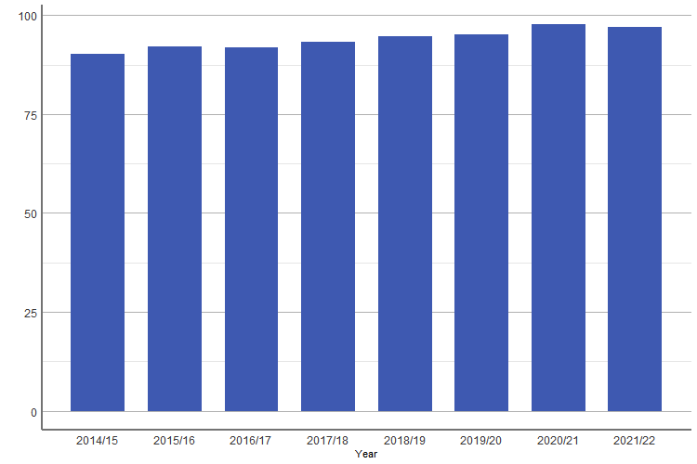
Demographics
There is a steady upwards trend in the completion of demographic fields, and generally, completion is good, but has plateaued.
Notes:
Demographics (6 fields in centre reports): the average of NHS Number and Postcode, which are essential for analyses of re-intervention rates and maps of geographic provision. Other fields are technically mandatory and, therefore 100% by definition.
1.03 NHS Number
1.04 Surname
1.05 Forename
1.06 DOB
1.07 Sex
1.09 Postcode

Slide 56
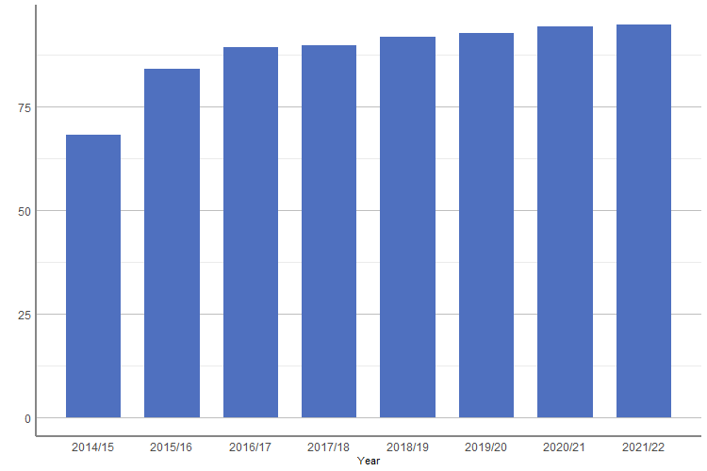
Clinical (Simple)
Again, there has been a steady increase in the completion of fields describing the indication for simple ablations.
Notes:
The average completeness of six fields that describe the clinical indication for simple ablations.
X2.01.Underlying.heart.dis
X2.02.Prev.surg.or.interventn
X2.03.Structural.congen.HD
X2.04.Documented.prior.AF
X2.05.Other.doc..arrhythmia
X2.06.Indication.for.proced

Slide 57
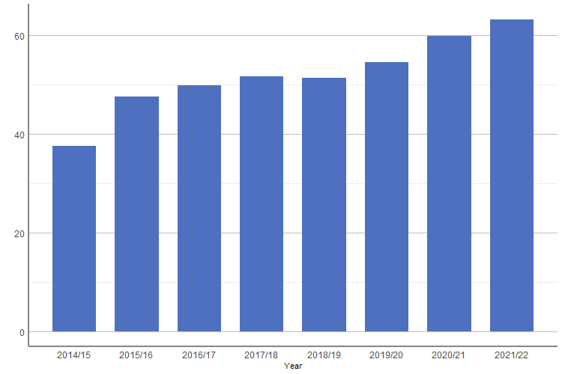
Clinical (Complex)
Completion of these fields has generally been poor, but is improving markedly.
Notes:
The average completeness of fields that describe the clinical indications for AF ablation. These fields are not required for other ablations.
4.01 LA size/vol
4.03 Rhyt at start
4.04 Prev AADS

Slide 58
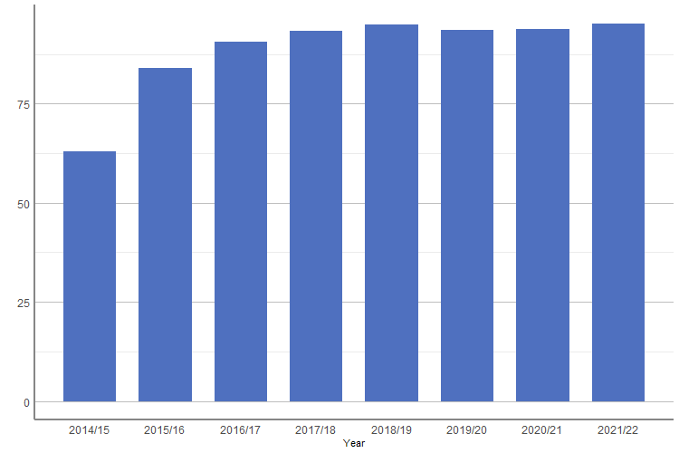
GMC
Broadly flat.
Notes:
The average GMC Registration Number completion rate for the first operator and responsible consultant.
X3.04.First.Op.GMC
X3.10.Cons.GMC

Slide 59
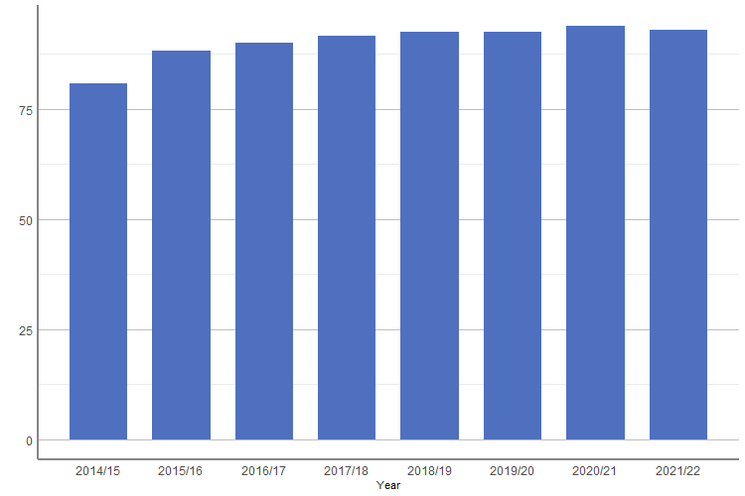
Procedure details
Broadly flat.
Notes:
The average completion rate of the following fields:
X3.01.Procedure.time
X3.02.Procedure.urgency
X3.12.Ablation.procedure
X3.13.Mapping.techniques
X3.16.Fluoro.time..min
X3.18.Proc.duration
X3.19.Ablation.attempted
X3.21.Ablation.energy.source
X3.23.Transseptal.approach
X3.24.Epicardial.approach
X3.26.Success
X3.2.Acute.complication

Slide 60
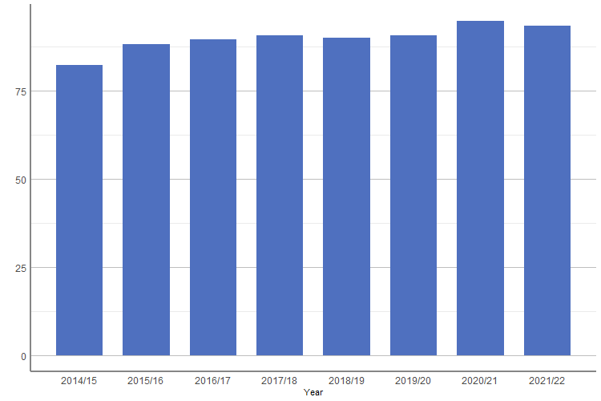
Ablation Validity
This is improving, but still below the 90% target.
Notes:
Consistency and completeness of the fields ‘ablation performed?’

Slide 61
Hospital Volumes
Devices

Slide 62
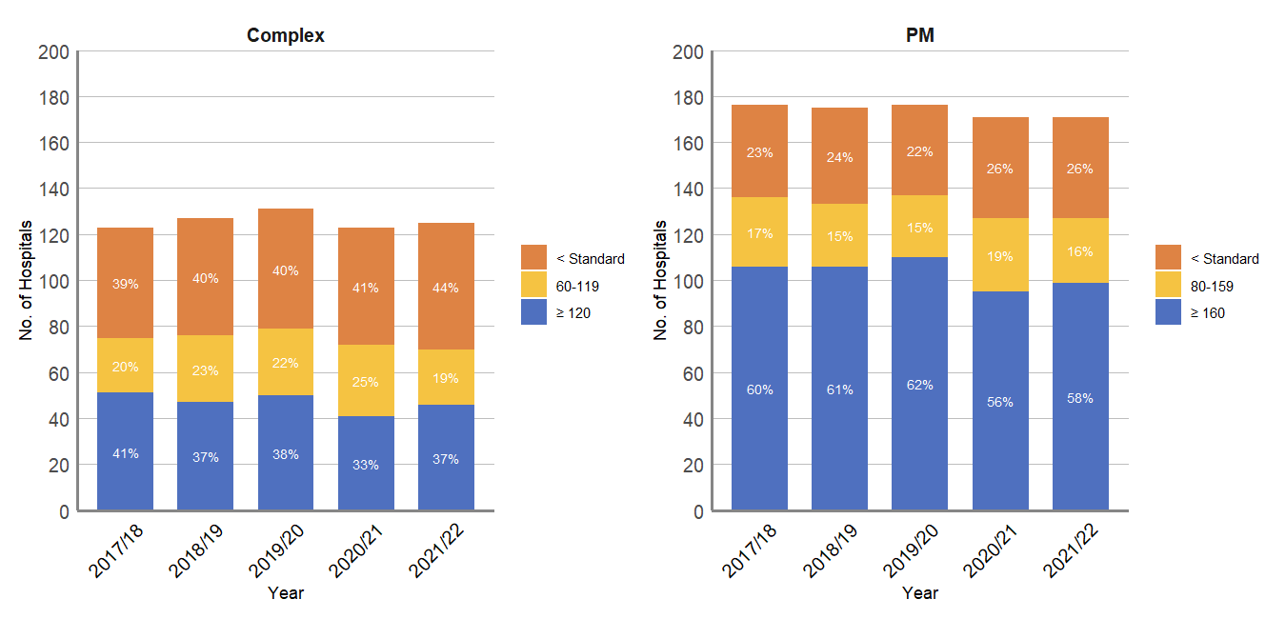
Hospitals Meeting Standards
Implants and upgrades
Complex Devices (>60pa)
Simple Devices (>80pa)

Slide 63
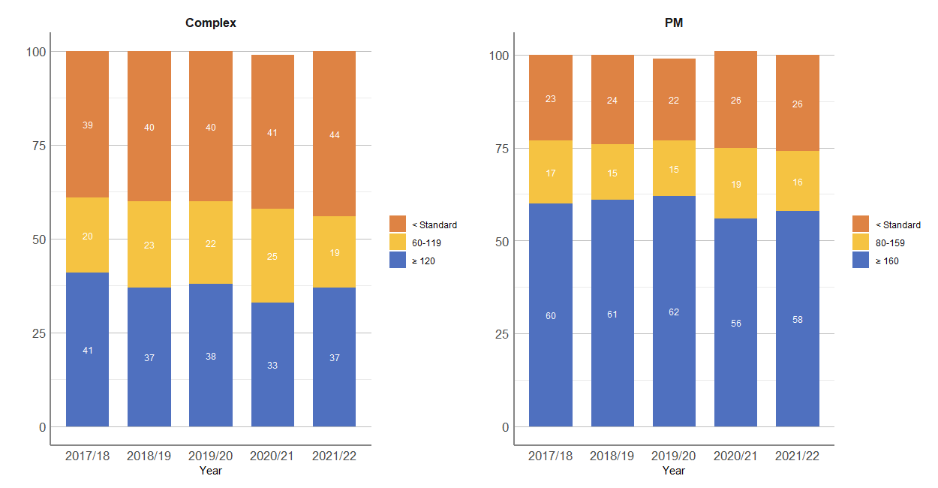
Hospitals Meeting Standards
Complex Devices Simple Devices

Slide 64
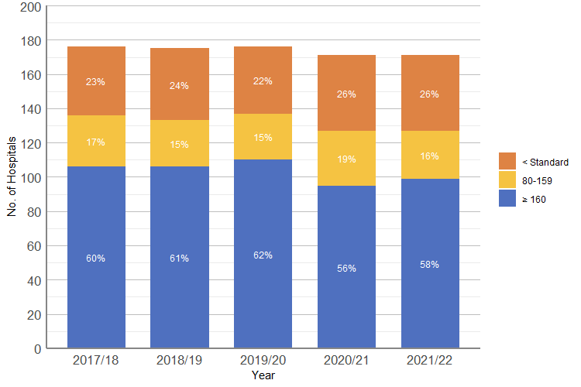
Hospitals Meeting Standards - Pacemakers

Slide 65
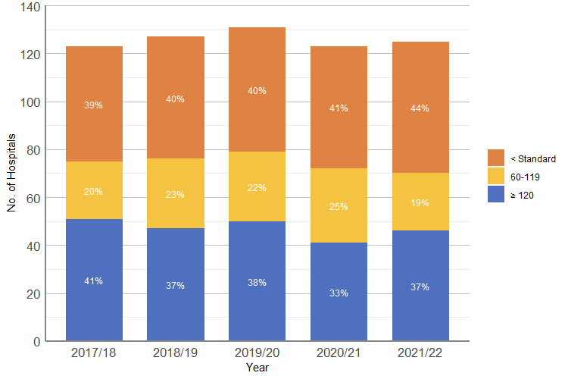
Hospitals Meeting Standards - Complex

Slide 66
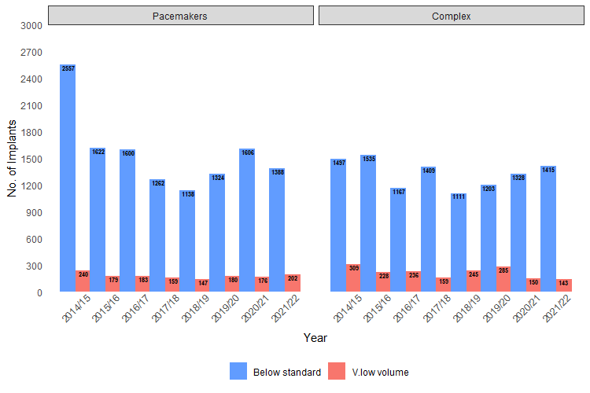
Device Implant Count – Low Volume Centres

Slide 67
Hospital Volumes Over Time
Number of hospitals by year and device type
 | 2014/15 | 2015/16 | 2016/17 | 2017/18 | 2018/19 | 2019/20 | 2020/21 | 2021/22
Simple
Number of NHS Adult Hospitals | 164 | 170 | 165 | 163 | 158 | 156 | 146 | 143
Number of NHS Adult Hospitals below standards | 57 | 31 | 29 | 29 | 26 | 26 | 32 | 30
Percentage of NHS Adult Hospitals below standards | 34.8 | 18.2 | 17.6 | 17.8 | 16.5 | 16.7 | 21.9 | 21.0
Number of Private Hospitals | 17 | 18 | 18 | 17 | 17 | 17 | 16 | 16
Number of Private Hospitals below standards | 17 | 17 | 16 | 14 | 14 | 14 | 13 | 16
Percentage of Private Hospitals below standards | 100.0 | 94.4 | 88.9 | 82.4 | 82.4 | 82.4 | 81.3 | 100.0
Number of Children Hospitals | 4 | 4 | 4 | 3 | 4 | 5 | 2 | 2
Number of Children Hospitals below standards | 4 | 4 | 4 | 3 | 4 | 5 | 2 | 2
Percentage of Children Hospitals below standards | 100.0 | 100.0 | 100.0 | 100.0 | 100.0 | 100.0 | 100.0 | 100.0
Total Number of Hospitals | 185 | 192 | 187 | 183 | 179 | 178 | 164 | 161
Total Number of Hospitals below standards | 78 | 52 | 49 | 46 | 44 | 45 | 47 | 48
Percentage of All Hospitals below standards | 42.2 | 27.1 | 26.2 | 25.1 | 24.6 | 25.3 | 28.7 | 29.8
Complex
Number of NHS Adult Hospitals | 99 | 112 | 112 | 112 | 112 | 111 | 103 | 97
Number of NHS Adult Hospitals below standards | 61 | 53 | 41 | 43 | 40 | 39 | 42 | 40
Percentage of NHS Adult Hospitals below standards | 61.6 | 47.3 | 36.6 | 38.4 | 35.7 | 35.1 | 40.8 | 41.2
Number of Private Hospitals | 16 | 15 | 17 | 15 | 15 | 16 | 13 | 16
Number of Private Hospitals below standards | 16 | 15 | 17 | 15 | 14 | 16 | 13 | 16
Percentage of Private Hospitals below standards | 100.0 | 100.0 | 100.0 | 100.0 | 93.3 | 100.0 | 100.0 | 100.0
Number of Children Hospitals | 4 | 4 | 3 | 3 | 5 | 4 | 2 | 2
Number of Children Hospitals below standards | 4 | 4 | 3 | 3 | 5 | 4 | 2 | 2
Percentage of Children Hospitals below standards | 100.0 | 100.0 | 100.0 | 100.0 | 100.0 | 100.0 | 100.0 | 100.0
Total Number of Hospitals | 119 | 131 | 132 | 130 | 132 | 131 | 118 | 115
Total Number of Hospitals below standards | 81 | 72 | 61 | 61 | 59 | 59 | 57 | 58
Percentage of All Hospitals below standards | 68.1 | 55.0 | 46.2 | 46.9 | 44.7 | 45.0 | 48.3 | 50.4

Slide 68
Hospital Volumes
Ablations

Slide 69
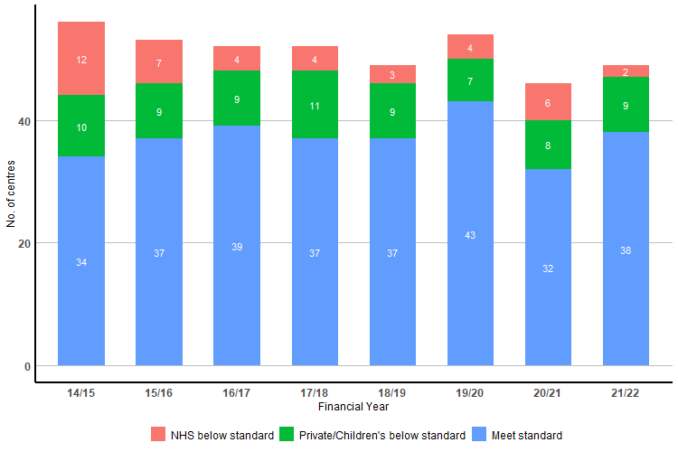
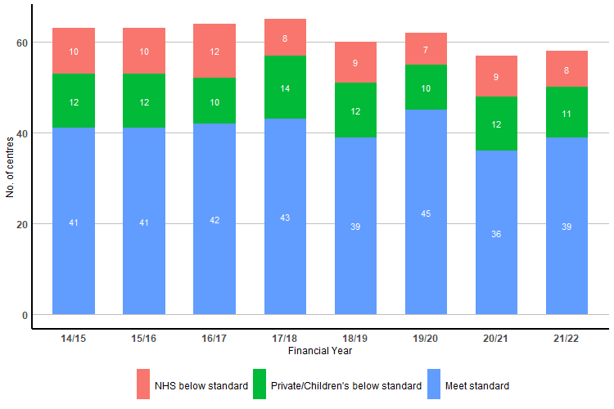
Hospitals Meeting Standards
AF Ablation (>50pa)
All Ablation (>100pa)

Slide 70
Hospitals Meeting Standards – All Ablation
There has been a slight fall in the numbers of NHS hospitals falling below the BHRS standards of 100 ablations per annum – 19 vs 21 in 2020/21.
However, the number remains stubbornly high.
Notes:
.

Slide 71
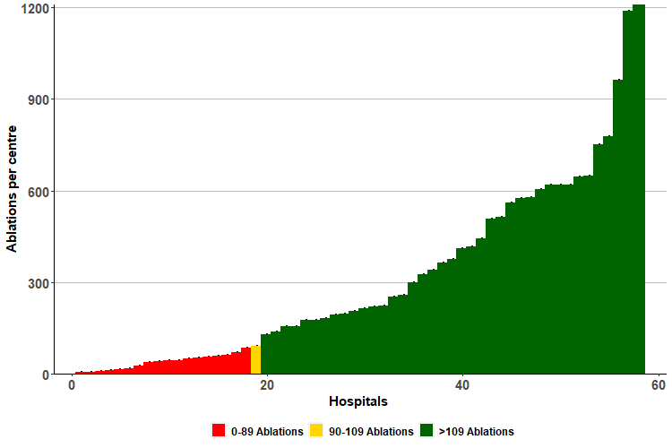
Quality Standard (5) – Catheter Ablation. Centres.
“Centres performing catheter ablation procedures should undertake a minimum of 100 ablations per year”
19 hospitals reported fewer than 100 ablations.
The majority were private hospitals, although a number were district general hospitals.
Notes:
Cleveland Clinic
Royal Berkshire Hospital
Spire Hull And East Riding Hospital
Spire Manchester Hospital
BMI The Alexandra Hospital
Spire Nottingham Hospital
North Middlesex University Hospital
Spire Hospital Cardiff
Royal Surrey County Hospital
Birmingham Childrens Hospital
Alder Hey Hospital
William Harvey Hospital
Queen Elizabeth The Queen Mother Hospital
Spire Leeds Hospital
BMI The Priory Hospital Birmingham
Great Ormond Street Hospital
Wexham Park Hospital
Watford General Hospital
Exeter Heart

Slide 72
Quality Standard (6) – AF Ablation. Centres.
This is the same data, viewed over time.
Predictably, the greater the number of procedures, the more likely centres were to undertake sufficient ablations to meet BHRS standards for AF ablation.

Slide 73
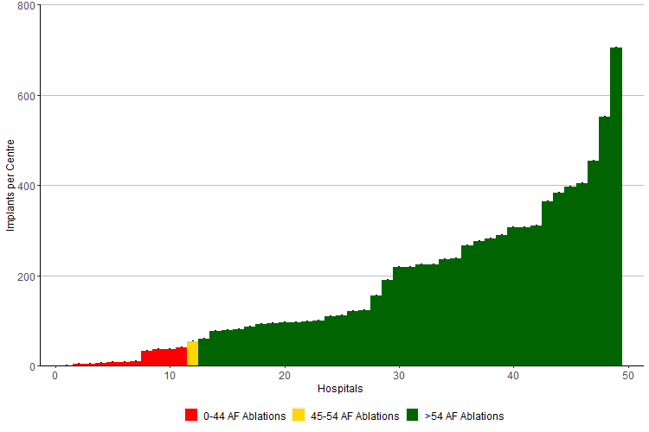
Quality Standard (6) – AF Ablation. Centres.
“Centres undertaking catheter ablation for AF should…perform a minimum of 50 AF ablations per year”
Most centres undertook more than 50 ablations (n=37).
Of those who reported undertaking AF ablation (n=49)
  11 hospitals reported fewer than 50 ablations.
  One reported 54 ablations.
Notes:
https://bhrs.com/standards/
https://bhrs.com/wp-content/uploads/2020/04/British-Heart-Rhythm-Society-Standards-Ablation-2020-1.pdf
Great Ormond Street Hospital
Alder Hey Hospital
Spire Hull And East Riding Hospital
Spire Hospital Cardiff
Spire Manchester Hospital
BMI The Alexandra Hospital
Spire Nottingham Hospital
Spire Leeds Hospital
Maidstone Hospital
University Hospital Of Wales
BMI The Priory Hospital Birmingham

Slide 74
Operator Volumes - Devices

Slide 75
Note
For devices, numbers here are for 1st operator + 2nd operator + supervising consultant
It’s just possible that some high-volume operators aren’t 1st operator quite so often…

Slide 76
Operator Volumes
CRM Procedures | 2019-20 | 2020-21 | 2021-22
Total Number of Operators Performing A Device Procedure | 1504 | 1438 | 1416
Cardiology | 955 | 873 | 808
Paediatric Cardiology | 20 | 15 | 16
Trainee | 291 | 320 | 350
Not Cardiology | 36 | 31 | 27
Cardiothoracic Surgeons | 62 | 44 | 42
Unknown | 140 | 155 | 173
QS7 - Operators performing at least 35 new/upgrades per annum | 550 | 498 | 520
QS7 - Trainees performing at least 35 new/upgrade procedures per annum | 16 | 26 | 43
Number of Operators Performing a Pacemaker implant/upgrades
Total | 1373 | 1324 | 1288
Cardiology | 911 | 830 | 753
Paediatric Cardiology | 12 | 11 | 12
Trainee | 266 | 297 | 331
Not Cardiology | 25 | 22 | 19
Cardiothoracic Surgeons | 38 | 30 | 22
Unknown | 121 | 134 | 151
QS8 - Complex operators performing at least 60 devices per annum, of which 30 are complex | 213 | 155 | 180
QS8 - Trainee complex operators performing at least 60 devices per annum, of which 30 are complex | 2 | 3 | 15
Number of Operators Performing a CRT/ICD implant/upgrade
Total | 844 | 805 | 803
Cardiology | 598 | 540 | 489
Paediatric Cardiology | 11 | 9 | 11
Trainee | 150 | 173 | 206
Not Cardiology | 12 | 7 | 5
Cardiothoracic Surgeons | 17 | 8 | 12
Unknown | 56 | 68 | 80

Slide 77
Device Procedures – Operator Numbers
New implants and upgrades
Notes:
New implants and upgrades

Slide 78
Trainees – all device implants/upgrades
The number of high-volume trainees is low and falling

Slide 79
Trainees – complex device implant/upgrades
The number of high-volume trainees is low and falling

Slide 80
There are comparatively few high-volume operators
Distribution of device procedure numbers and changes over time

Slide 81
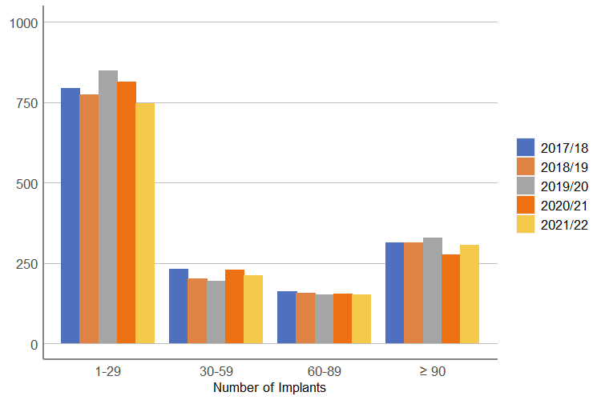
All Device Implants/Upgrades, All Operators
A biphasic distribution – a lot of low-volume operators and a significant number (250+) of higher-volume operators

Slide 82
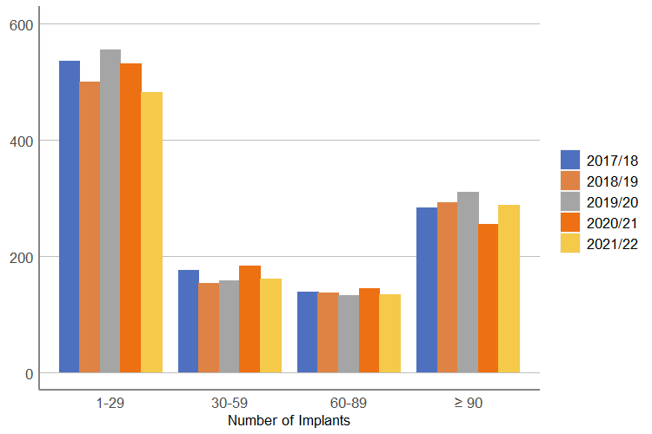
All Device Implants/Upgrades, Excluding Trainees

Slide 83
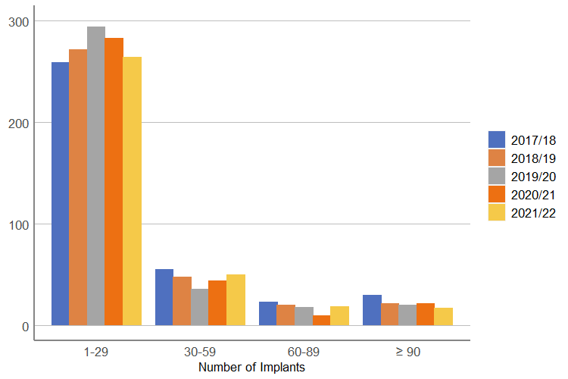
All Device Implants/Upgrades, Trainees

Slide 84
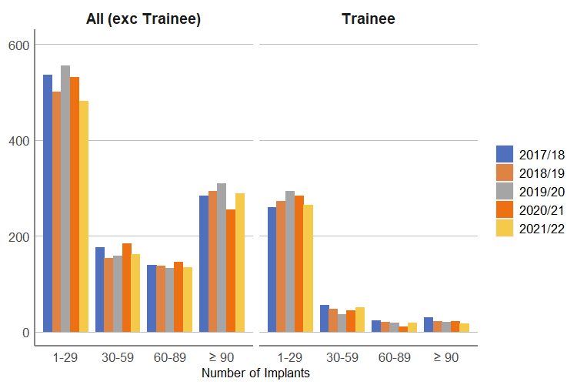
All Device Implants/Upgrades, divided by trainees and the remainder
There are only a handful of high-volume trainees

Slide 85
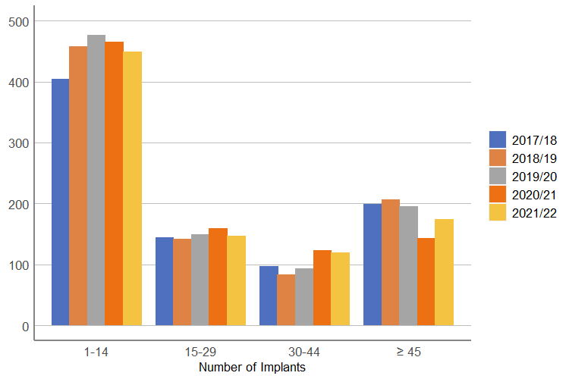
Complex Implants/Upgrades, All Operators
There is a gradual shift towards higher-volume operators

Slide 86
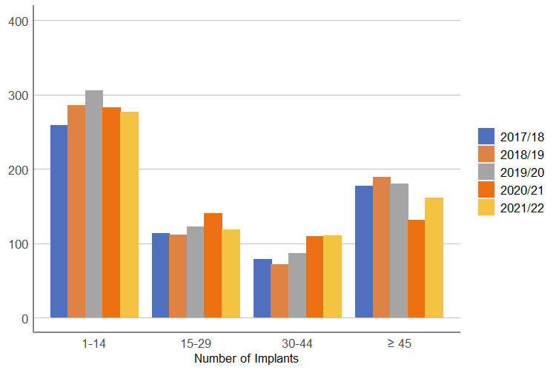
Complex Device Implants/Upgrades, Excluding Trainees

Slide 87
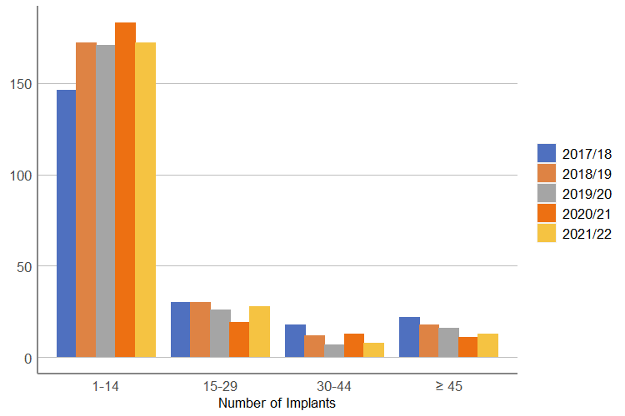
Complex Device Implants/Upgrades, Trainees

Slide 88

Complex Implants/Upgrades, Trainees and the remainder
Very few high-volume trainees

Slide 89
Operator Volumes - Ablations
1st and 2nd operator

Slide 90
Abalations – Operator Numbers
Notes:
Ablations

Slide 91
Operators – Number of Procedures
 | 2019-2020 | 2020-2021 | 2021-2022
Total Ablations
Total number of operators performing an ablation | 398 | 408 | 422
Cardiologists | 297 | 282 | 268
Paediatric Cardiologists | 14 | 10 | 9
Trainees | 53 | 79 | 96
Not cardiologists | 5 | 2 | 5
Unknown | 29 | 35 | 44
QS 9 – Operators performing at least 50 ablations per year | 201 | 177 | 212
QS 9 – Trainees performing at least 50 ablations per year | 2 | 3 | 14
Simple Ablation
Total number of operators performing simple ablation | 371 | 381 | 397
Cardiologists | 281 | 270 | 260
Paediatric Cardiologists | 13 | 9 | 9
Trainees | 46 | 74 | 90
Not cardiologists | 3 | 0 | 2
Unknown | 28 | 28 | 36
QS 10 – Operators performing at least 25 simple ablations per year | 178 | 157 | 178
QS 10 – Trainees performing at least 25 simple ablations per year | 1 | 3 | 11
Complex Ablation
Total number of operators performing complex ablation | 346 | 341 | 354
Cardiologists | 269 | 248 | 243
Paediatric Cardiologists | 10 | 9 | 7
Trainees | 40 | 52 | 61
Not cardiologists | 5 | 2 | 3
Unknown | 22 | 30 | 40
QS11 – Operators performing at least 50 ablations, with at least 25 being complex | 191 | 161 | 202
QS11 – Operators performing at least 50 complex ablations per annum | 139 | 75 | 129
QS11 – Trainees performing at least 50 ablations, with at least 25 being complex | 2 | 3 | 13
QS11 – Trainees performing at least 50 complex ablations per annum | 0 | 0 | 3
A marked increase in the number of trainees involved with at least one ablation – 46 in 2019/20 to 90 in 2021/22
Notes:
The following table details operator volumes. A small number of operators were not cardiologists – they were, for example, anaesthetists, and their details have probably been entered in error. 45 operators were “unknown”. There were 100 trainees. The remaining 281 were cardiologists (n=272) or paediatric cardiologists (n=9).
222 performed at least 50 procedures, or which 16 were trainees. 178 performed at least 25 simple ablations, or which 11 were trainees. 202 performed at least 50 ablations with at least 25 of those classified as complex; 129 performed at least 50 complex ablations. Only 13 trainees undertook at least 25 complex procedures, and at least 50 ablations in total. Only 3 trainees undertook at least 50 complex procedures.

Slide 92
Ablations and Operators 2021-22

Slide 93

Trainees and Ablation
This chart demonstrates the numbers of trainees performing high and low volumes of procedures.
The proportion of trainees performing fewer procedures was markedly higher in 2020/2021 compared with previous years.
This has rebounded, and figures for all ablation in 2021/2022 look more like the years before the pandemic
However, the number of trainees performing high volumes of complex ablation has not yet recovered completely.

Slide 94
Trainees and Ablation
This chart demonstrates the numbers of trainees performing high and low volumes of procedures.
The proportion of trainees performing fewer procedures was markedly higher in 2020/2021 compared with previous years.
This has rebounded, and figures for all ablation in 2021/2022 look more like the years before the pandemic
However, the number of trainees performing high volumes of complex ablation has not yet recovered completely.

Slide 95
NICE Guidelines

Slide 96
Standards for complex and simple devices
A data entry issue?

Slide 97
NICE – Compliance Sinus Node Disease

Slide 98
NICE Compliance – AV Block

Slide 99

NICE Compliance – Appropriate Pacemaker Type

Slide 100
NICE Primary Prevention ICDs

Slide 101
NICE ICDs Secondary Prevention

Slide 102

NICE Compliance – Appropriate ICD Type

Slide 103
Re-intervention rates
1st implant only

Slide 104
Reintervention rates - devices

Slide 105

Legend - Explanation
The red diamonds represent hospitals with less than 90% complete NHS numbers in 2020/21 and 21/22 for 1-year re-intervention and 2019/20, 2020/21 and 21/22 for 2-year re-intervention.
The blue diamonds represent Hospitals with at least 90% complete NHS numbers in 2020/21 and 21/22 for 1-year re-intervention and 2019/20, 2020/21 and 21/22 for 2-year re-intervention.
The horizontal blue line is the mean.
The dotted blue line is the 95% CI.
The red line is the 99% CI.

Slide 106

Pacemaker Reintervention rates

Slide 107

Complex Device Reintervention rates

Slide 108
Reintervention rates for ablation procedures, 2015/16 to 2020/21
 | Simple Atrial 1 Year | Simple Atrial 2 Year | Complex Atrial 1 Year | Complex Atrial 2 Year | Ventricular 1 Year | Ventricular 2 Year
2015/16 | 3.1 | 4.5 | 9.9 | 17.5 | 10.6 | 15.0
2016/17 | 3.5 | 4.9 | 10.0 | 18.0 | 12.0 | 16.4
2017/18 | 3.2 | 4.6 | 9.1 | 16.8 | 10.7 | 14.5
2018/19 | 3.1 | 3.6 | 8.0 | 10.3 | 8.4 | 9.8
2019/20 | 1.7 | 5.1 | 1.9 | 13.3 | 4.7 | 12.8
2020/21 | 3.0 | - | 7.3 | - | 8.2 | -

Slide 109
Reintervention rates for ablation procedures, 2015/16 to 2020/21
 | Simple Atrial 1 Year | Simple Atrial 2 Year | Complex Atrial 1 Year | Complex Atrial 2 Year | Ventricular 1 Year | Ventricular 2 Year
2015/16 | 3.1 | 4.5 | 9.9 | 17.5 | 10.6 | 15.0
2016/17 | 3.5 | 4.9 | 10.0 | 18.0 | 12.0 | 16.4
2017/18 | 3.2 | 4.6 | 9.1 | 16.8 | 10.7 | 14.5
2018/19 | 3.1 | 3.6 | 8.0 | 10.3 | 8.4 | 9.8
2019/20 | 1.7 | 5.1 | 1.9 | 13.3 | 4.7 | 12.8
2020/21 | 3.0 | - | 7.3 | - | 8.2 | -

Slide 110

Now, what struck me as so important in this study was that hospitals with a high overall ablation volume had almost one-third lower odds of early mortality…compared with those with the lowest volume…
Expert teams with higher volumes generally experience lower rates of complications and deaths, and that raises the question of whether we should have specialty hospitals in the United States, areas that have high volume for complicated procedures such as atrial fib ablation...
https://www.practiceupdate.com/content/dr-doug-zipes-on-atrial-fibrillation-updates-from-acc-2023/149612/15/2/3
Notes:
Zipes
Real-world outcomes of ablation
Now, many sites are using atrial fibrillation, and one of the other studies presented is called the Initial Findings From the National Cardiovascular Data Registry of Atrial Fibrillation Ablation Procedures by Hsu et al. And this was to document real-world outcomes of atrial fibrillation. The authors found that early mortality rates were 0.2% in outpatient ablation procedures and higher, 2.4%, for inpatient procedures, and that's most likely explained by the increased comorbidities of patients being admitted to the hospital for the procedure. Pulmonary vein isolation was accomplished in 92% of patients.
High-volume advantage
Now, what struck me as so important in this study was that hospitals with a high overall ablation volume had almost one-third lower odds of early mortality, an odds ratio of 0.69, compared with those with the lowest volume. While all of these numbers are satisfying and low, the critical finding I think is consistent; that is, the high-volume outcome is consistent with multiple other studies on atrial fib and other complicated procedures, including surgery. Expert teams with higher volumes generally experience lower rates of complications and deaths, and that raises the question of whether we should have specialty hospitals in the United States, areas that have high volume for complicated procedures such as atrial fib ablation, and that these complex procedures should not be performed by everyone who is an MD. Obviously, that will raise all kinds of issues, but nevertheless, I think it is an important consideration and one that really much of Europe embraces.
Ablation
Now, ablation of atrial fibrillation has gained widespread acceptance as an initial treatment for many patients, producing better cardiovascular outcomes and quality of life than antiarrhythmic drugs, for example, or rate control. Catheter ablation of arrhythmias can be associated with severe complications, often dependent on the kind of atrial fib, its complexity, whether the pulmonary veins are isolated alone, or there’s more ablation, and patient comorbidities. Importantly, as I’ll come back to, is the experience of the performing centers.
Cryoablation
Now, multiple new publications have advanced the field and particularly highlighted during this year's ACC meeting in New Orleans. While radiofrequency catheter ablation has been the standard, cryoablation, freezing that is, has also been successful. For example, a study published in New England Journal of Medicine by Andrade et al called Progression of Atrial Fibrillation after Cryoablation or Drug Therapy showed that initial treatment of paroxysmal atrial fib with catheter cryoablation was associated with a lower incidence of persistent atrial fib or recurrent atrial tachyarrhythmias over a 3-year follow-up compared to the use of antiarrhythmic drugs.
Pulsed field ablation
Highlighted at this meeting is the newest of ablation techniques. For example, a study by Verma et al published in Circulation called Pulsed Field Ablation for Treatment of Atrial Fibrillation showed that this new ablation technique, that is, pulsed field, was successful in a subset of patients with both paroxysmal and persistent atrial fib, that it was safe and effective and took much less time than radiofrequency catheter ablation.
Now, pulsed field ablation uses electrical pulses to cause nonthermal irreversible electroporation, that is, holes in the cells that induce cardiac cell death. It's been very effective, and it may be the new ablation approach for atrial fib.

Slide 111


A repeat ablation procedure was done within 1 year in 9.5% of patients (median 1.0; IQR 1.0–1.0).
Notes:
https://pubmed.ncbi.nlm.nih.gov/28104790/ Eur Heart J. 2017 May 1;38(17):1303-1316. doi: 10.1093/eurheartj/ehw564. PMID: 28104790;
Contemporary management of patients undergoing atrial fibrillation ablation: in-hospital and 1-year follow-up findings from the ESC-EHRA atrial fibrillation ablation long-term registry
Elena Arbelo ¹, Josep Brugada ¹, Carina Blomström-Lundqvist ², Cécile Laroche ³, Josef Kautzner ⁴, Evgeny Pokushalov ⁵, Pekka Raatikainen ⁶, Michael Efremidis ⁷, Gerhard Hindricks ⁸, Alberto Barrera ⁹, Aldo Maggioni ³ ¹⁰, Luigi Tavazzi ¹¹, Nikolaos Dagres ⁸; on the behalf of the ESC-EHRA Atrial Fibrillation Ablation Long-term Registry Investigators
Aims: The ESC-EHRA Atrial Fibrillation Ablation Long-Term registry is a prospective, multinational study that aims at providing an accurate picture of contemporary real-world ablation for atrial fibrillation (AFib) and its outcome.
Methods and results: A total of 104 centres in 27 European countries participated and were asked to enrol 20-50 consecutive patients scheduled for first and re-do AFib ablation. Pre-procedural, procedural and 1-year follow-up data were captured on a web-based electronic case record form. Overall, 3630 patients were included, of which 3593 underwent an AFib ablation (98.9%). Median age was 59 years and 32.4% patients had lone atrial fibrillation. Pulmonary vein isolation was attempted in 98.8% of patients and achieved in 95-97%. AFib-related symptoms were present in 97%. In-hospital complications occurred in 7.8% and one patient died due to an atrioesophageal fistula. One-year follow-up was performed in 3180 (88.6%) at a median of 12.4 months (11.9-13.4) after ablation: 52.8% by clinical visit, 44.2% by telephone contact and 3.0% by contact with the general practitioner. At 12-months, the success rate with or without antiarrhythmic drugs (AADs) was 73.6%. A significant portion (46%) was still on AADs. Late complications included 14 additional deaths (4 cardiac, 4 vascular, 6 other causes) and 333 (10.7%) other complications.
Conclusion: AFib ablation in clinical practice is mostly performed in symptomatic, relatively young and otherwise healthy patients. Overall success rate is satisfactory, but complication rate remains considerable and a significant portion of patients remain on AADs. Monitoring after ablation shows wide variations. Antithrombotic treatment after ablation shows insufficient guideline-adherence.
A repeat ablation procedure was done in 9.5% of patients (median 1.0; IQR 1.0–1.0).

Slide 112
Reintervention Rates
Reintervention rates are one potential measure of quality and are a surrogate measure of success.
However, during the pandemic, many patients were not offered a second ablation.
Therefore a low re-intervention rate may be a sign of poor care, as trial data suggests re-intervention rates should be at least 20%.
This explains the dramatic fall in one-year and two-year re-intervention rates.
Nonetheless, there appears to be a fall in the re-intervention rates in those undergoing complex ablation.
As would be expected, the re-intervention rates for simple ablation are largely static; the apparent rise in the two-year re-intervention rate for these procedures probably represents “catch-up”.

Slide 113
Reintervention Rates
Reintervention rates are one potential measure of quality and are a surrogate measure of success.
However, during the pandemic, many patients were not offered a second ablation.
Therefore a low re-intervention rate may be a sign of poor care, as trial data suggests re-intervention rates should be at least 20%.
This explains the dramatic fall in one-year and two-year re-intervention rates.
Nonetheless, there appears to be a fall in the re-intervention rates in those undergoing complex ablation.
As would be expected, the re-intervention rates for simple ablation are largely static; the apparent rise in the two-year re-intervention rate for these procedures probably represents “catch-up”.

Slide 114

Reintervention Rates
Reintervention rates are one potential measure of quality and are a surrogate measure of success.
However, during the pandemic, many patients were not offered a second ablation.
Therefore a low re-intervention rate may be a sign of poor care, as trial data suggests re-intervention rates should be at least 20%.
This explains the dramatic fall in one-year and two-year re-intervention rates.
Nonetheless, there appears to be a fall in the re-intervention rates in those undergoing complex ablation.
As would be expected, the re-intervention rates for simple ablation are largely static; the apparent rise in the two-year re-intervention rate for these procedures probably represents “catch-up”.

Slide 115
1-Year Simple Atrial Re-Intervention Rate
The mean re-intervention rate for “simple” ablation was 3%.
This is broadly in line with previous years.
Two hospitals were above the 95% CI and 2 further hospitals were above the 99% CI.
Notes:
Outliers
99% CI
Norfolk and Norwich
Watford General
95% CI
Queen Alexandra Hospital
Harefield

Slide 116

2-Year Simple Atrial Re-Intervention Rate
The 2-year simple atrial re-intervention rate was 5.1% on average.
This was in line with previous years.
Two hospitals were above the 95% CI.
Two hospitals were above the 99% CI.
Notes:
Outliers
99% CI
Barts
Watford General
95% CI
Alder Hey
Great Ormond Street

Slide 117

1-Year Complex Atrial Re-Intervention Rates
On average, 7.3% of patients underwent re-intervention within 1 year.
Compared with the 2020 report (which looked at 2017/2018) data, the rate was lower. In 2017/2018, the rate was 9.1%. The data was not reported in 2021 or 2022.
No hospitals were outside of the 99% CI
4 hospitals were above the 95% CI
Notes:
Outliers
95% CI
Liverpool Heart and Chest Hospital
Leeds General Infirmary
The Spire, Bristol
James Cook

Slide 118

2-Year Complex Atrial Re-Intervention
The two-year complex atrial re-intervention rate was 13.3%, much lower than in 2015/6 (17.5%) and 2016/7 (18.0%).
One hospital was above the 95% CI line, and one was above the 99% CI line.
Notes:
Outliers
99% CI
Royal Bournemouth Hospital
95% CI
Bristol Royal Infirmary

Slide 119

1-Year Complex Ventricular Re-Intervention Rates
The mean 1-year complex ventricular re-intervention rate was 8.2%.
Two hospitals were above the 95% confidence interval.
No hospitals were above the 99% confidence interval.
This value is less than in 2015/2016 (10.6%) and 2016/2017 (12.0%), and 2017/2018 (10.7%).
Notes:
Outliers
95% CI
Manchester Royal Infirmary
Eastbourne District General Hospital

Slide 120

2-Year Complex Ventricular Re-Intervention Rates
There was also a reduction (compared to historical rates) of complex ventricular re-intervention.
The mean rate was 12.8%.
Three hospitals were beyond the 95% CI.
None were beyond the 99% CI.
Notes:
Outliers
95% CI
Barts and the London
Manchester Royal infirmary
Nottingham City Hospital

Slide 121
Conclusions
Some increase in activity in 2021-22 compared with 2022-23;
Not back to pre-pandemic levels;
Trainees – do we need to think about training programmes and how many trainees need to do to be good enough to move on;
Complication rates steady;
AF ablation – low rate of redo ablation within 1 year – so hospitals with higher rates might be functioning better.

